Slide 1
Personal Medical Expenses
Potential Factors May Effect Our Health Condition

Slide 2
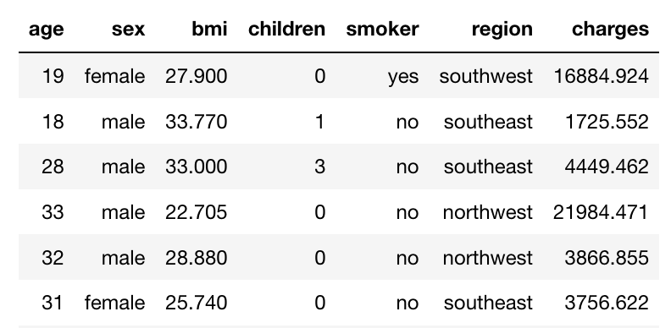
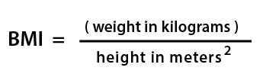

Information in the Dataset
From Kaggle.com
Total 1338 rows
bmi = kg/m²
charges = individual annual medical expenditure

Slide 3
Stakeholders & Potential Sponsor
Who want to know how to set product price for different groups of customers
Insurance Companies

Slide 4

Purpose
Objective: find correlation between different factors with annual medical expense
Which one of the factor has the strongest correlation with medical expenses
The expected outcome would be people in bad habit or health condition tend to spend more on medical expenses
My stakeholder could adjust the price setting according to the result of this project to maximize the profit

Slide 5
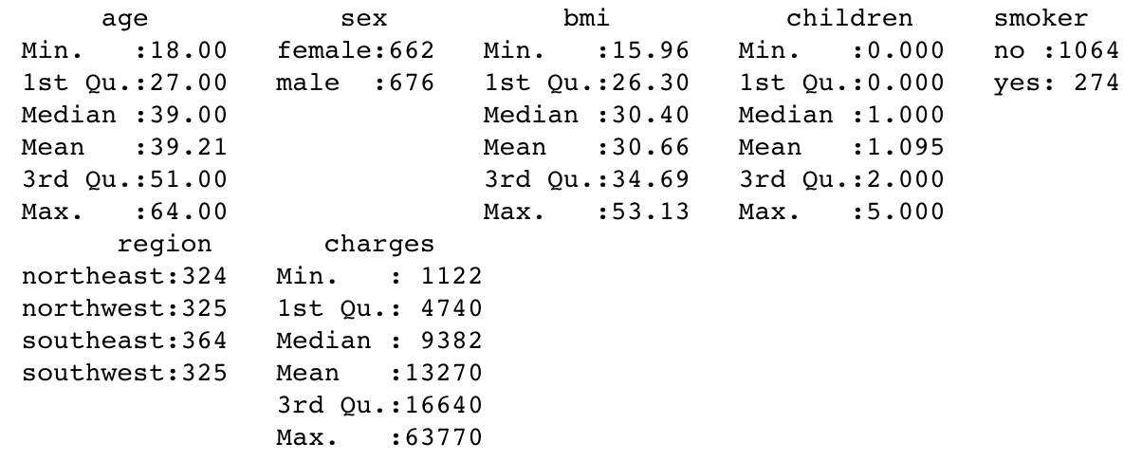
Summary(d)
A high BMI can be an indicator of high body fatness. BMI can be used to screen for weight categories that may lead to health problems. But itself is not a indicator of health condition. A normal range of BMI is between 18.5 ~ 24.9

Slide 6
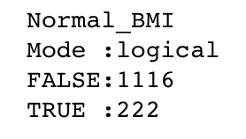
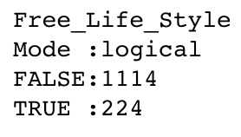
Adding New Columns
Normal_BMI (bmi is in 18.5 ~ 24.9)
Free_Life_Style (bmi is not in 18.5 ~ 24.9 also smokes)

Slide 7
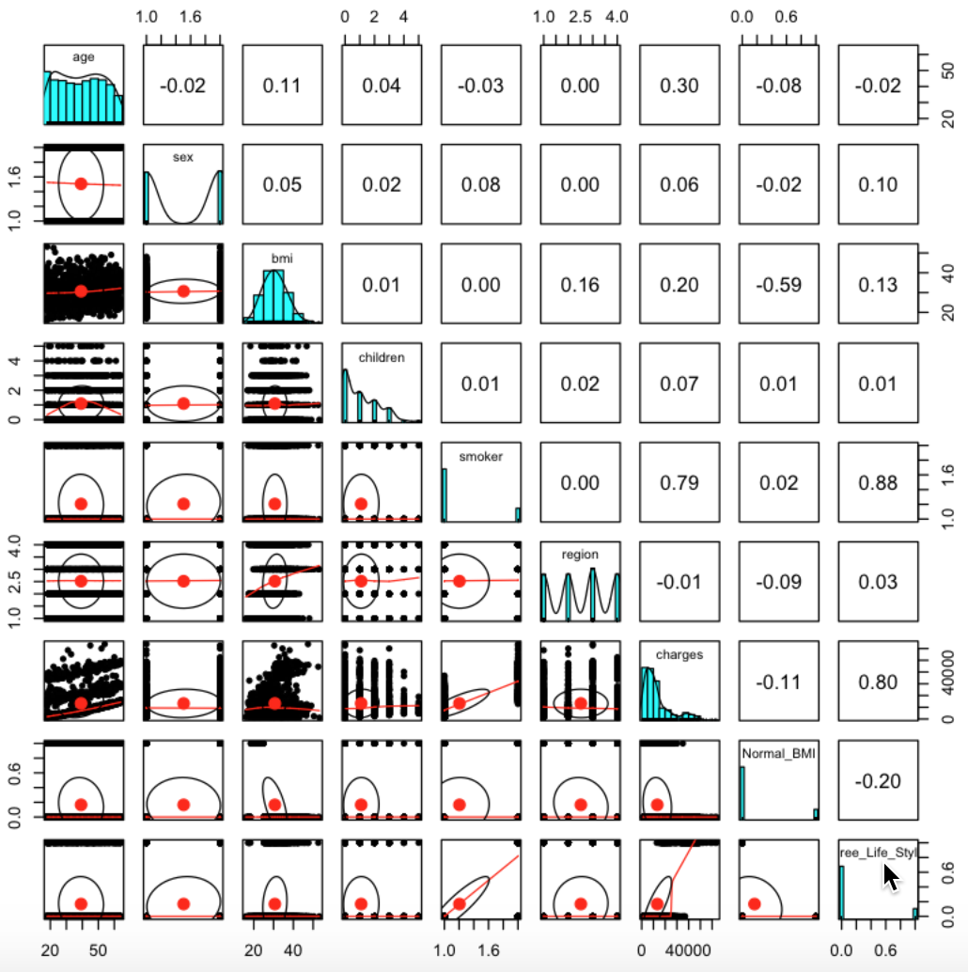
medical expense is highly correlated with smoker: 79%
adding unhealthy BMI increases the correlation to 80%
No. of children in family and region don’t seem to have correlation with medical expenses

Slide 8
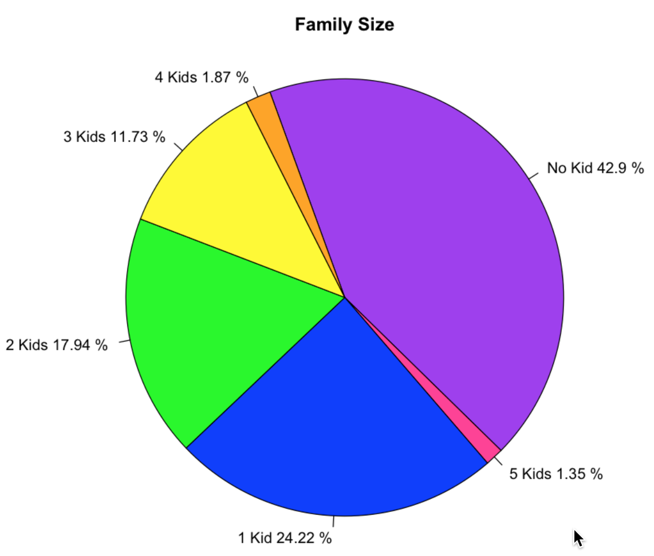
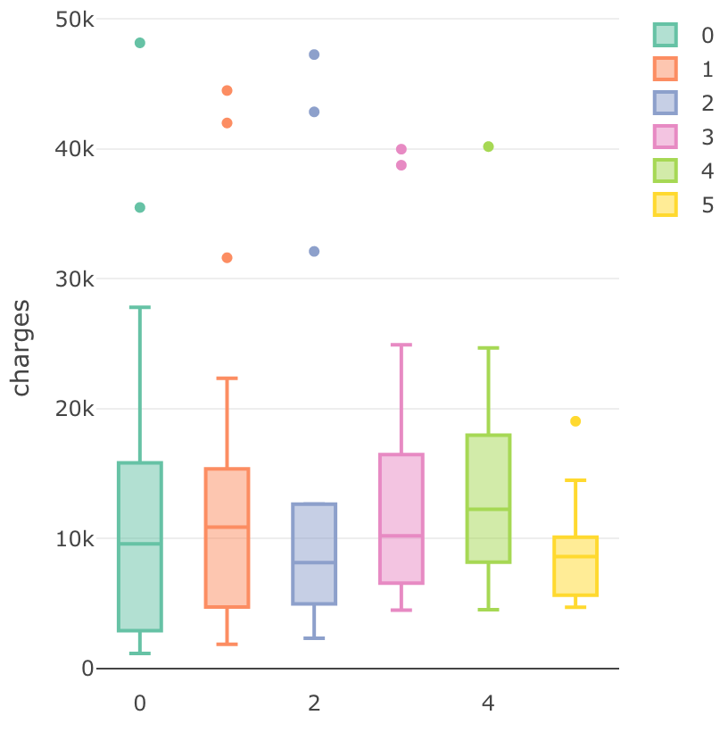
Sampling since not evenly distributed

Slide 9
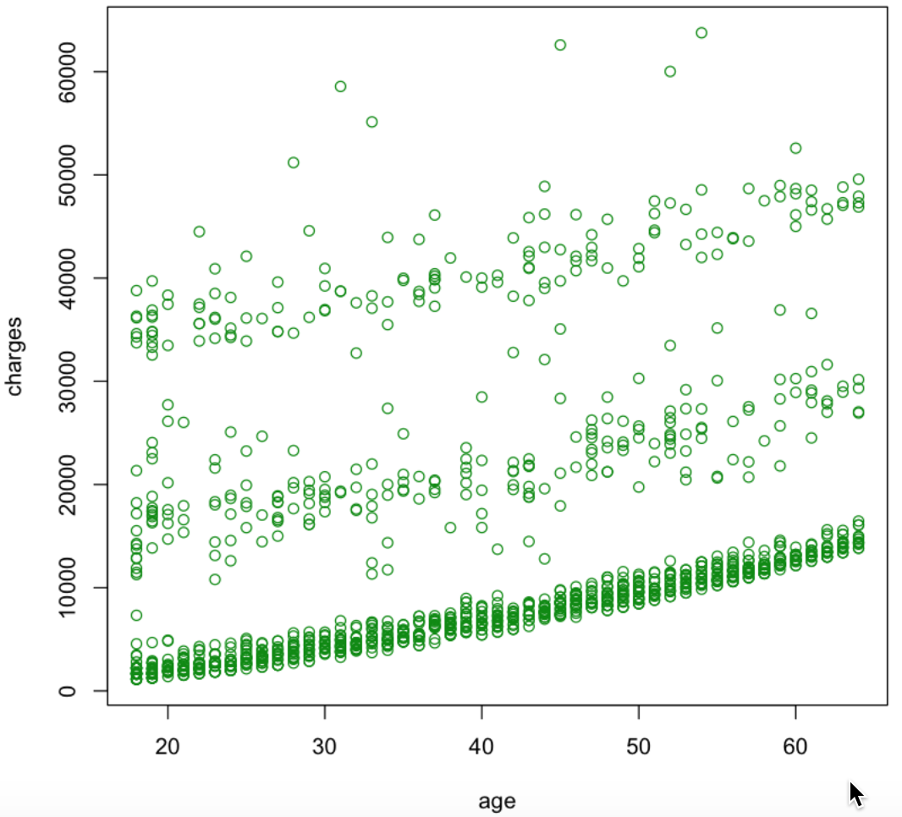
Charge ~ Age
not clear

Slide 10
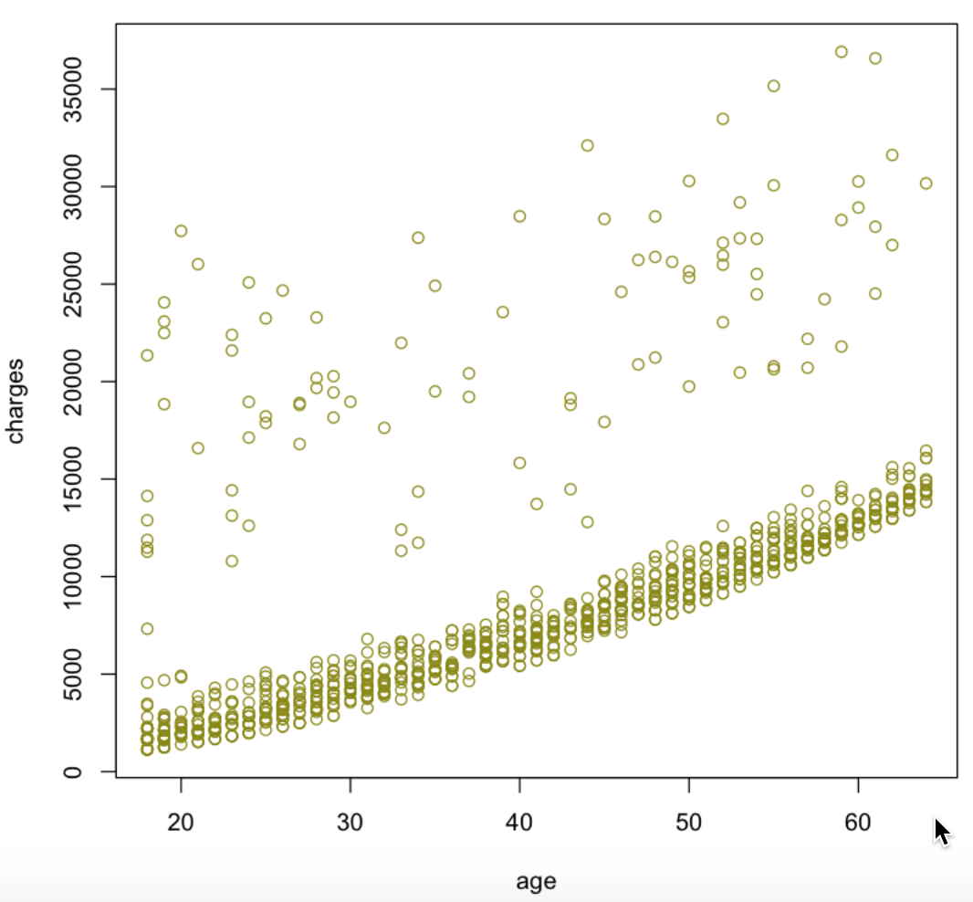
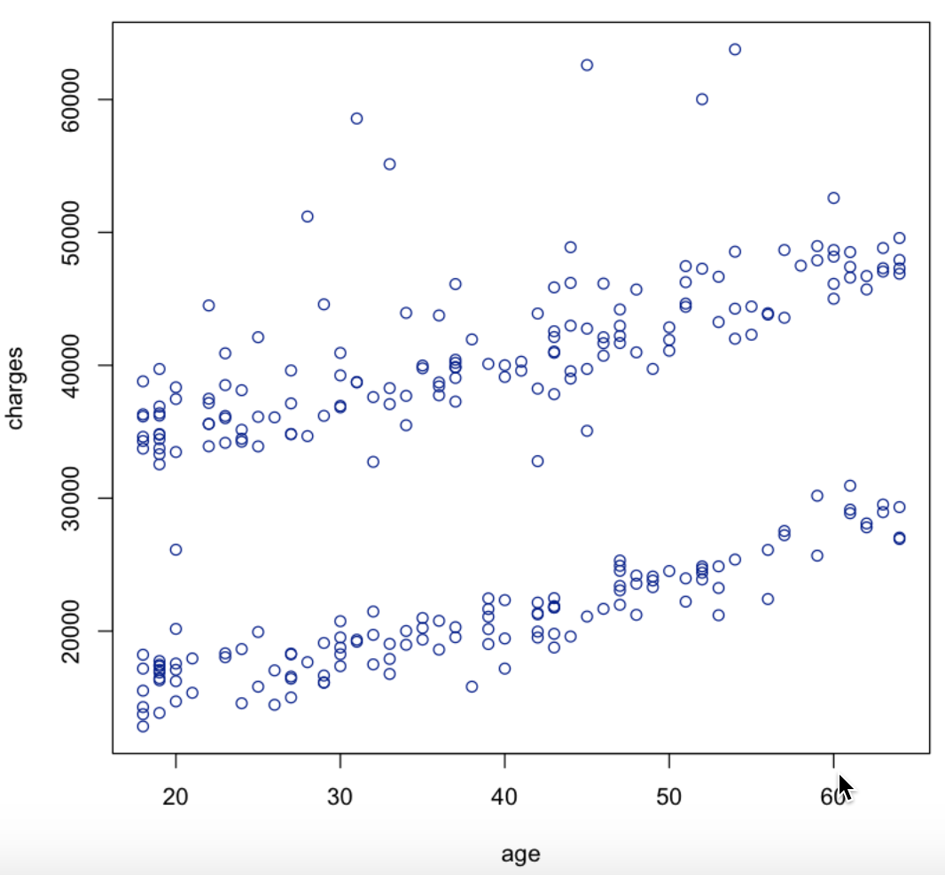
Subsetting
Nonsmoker
Smoker

Slide 11
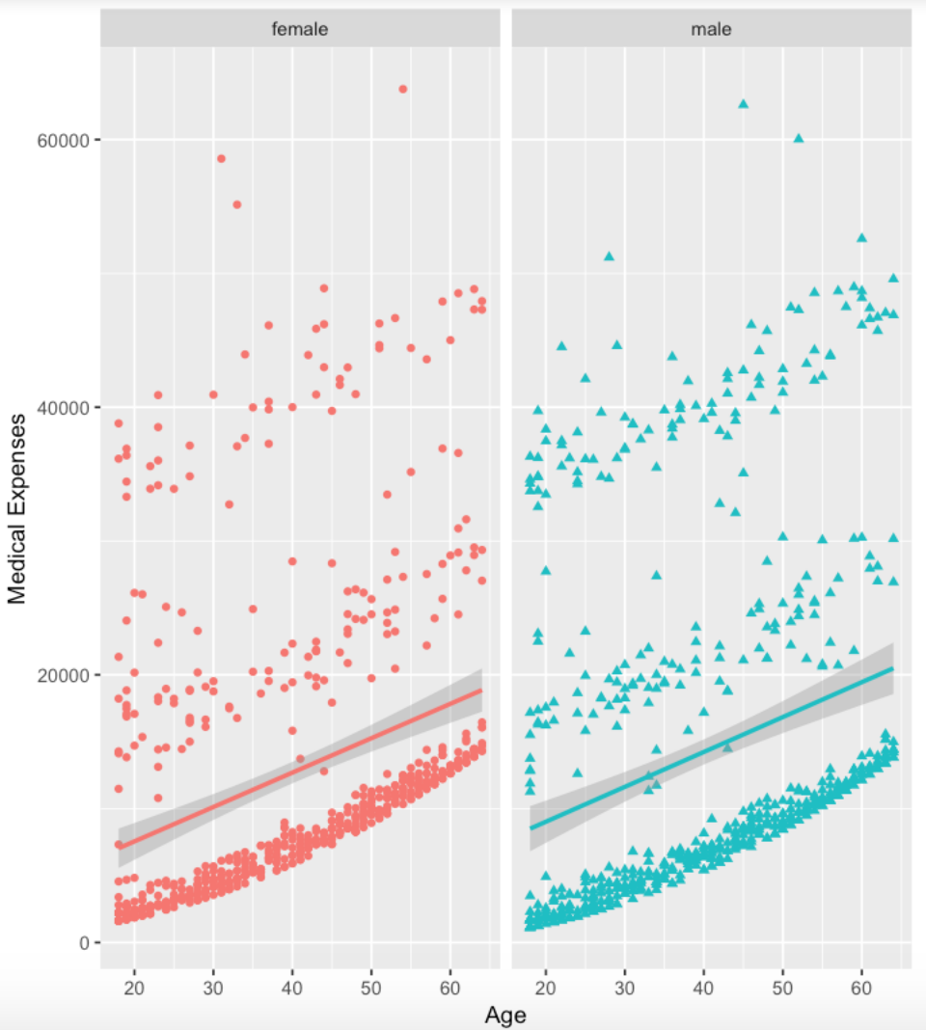
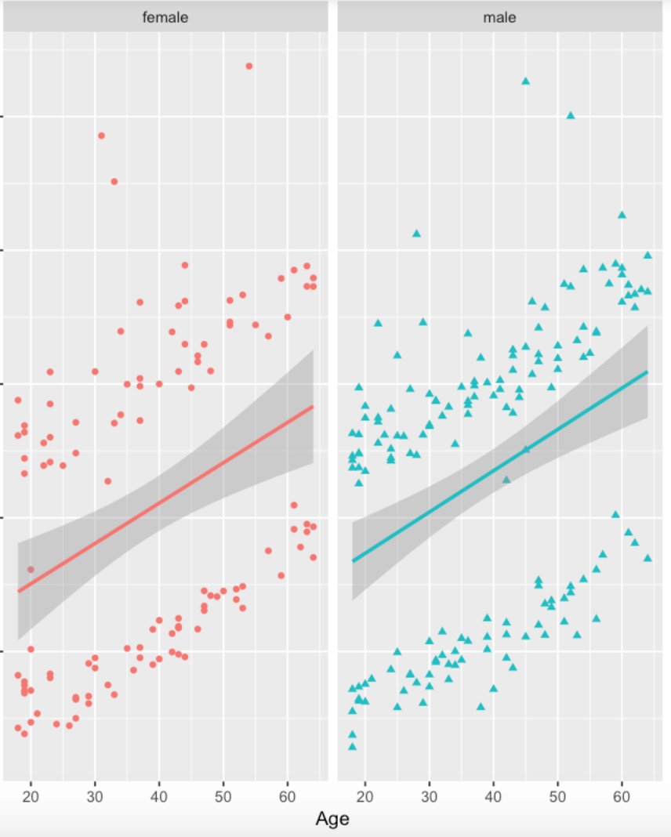
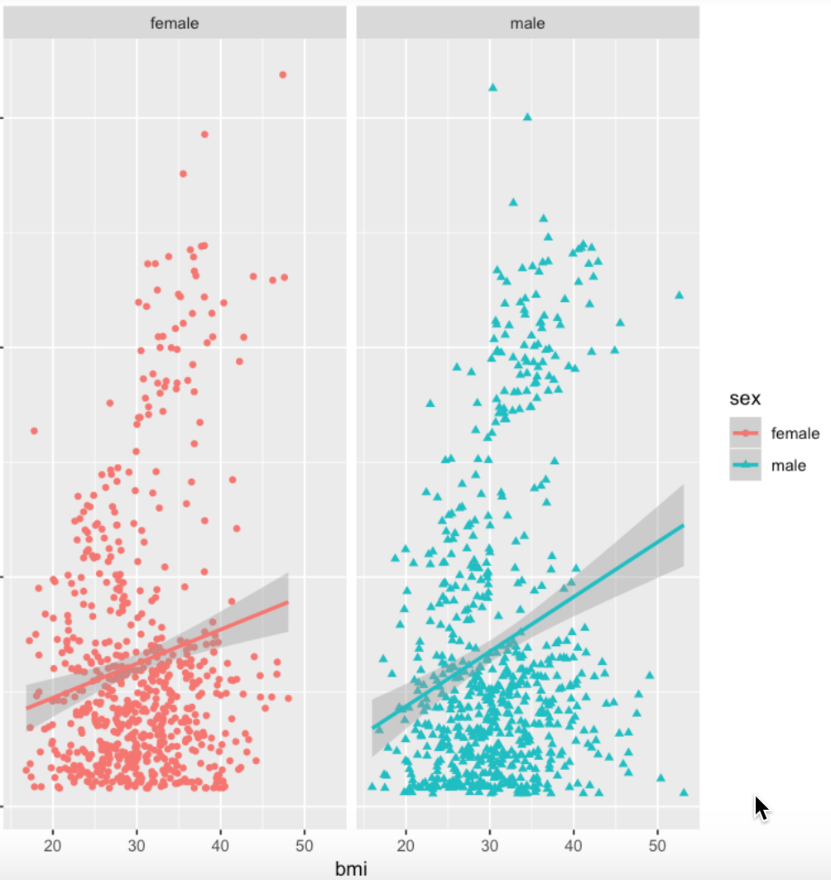
Compare gender
age effect same
smoke effect same
bmi effect differently?

Slide 12
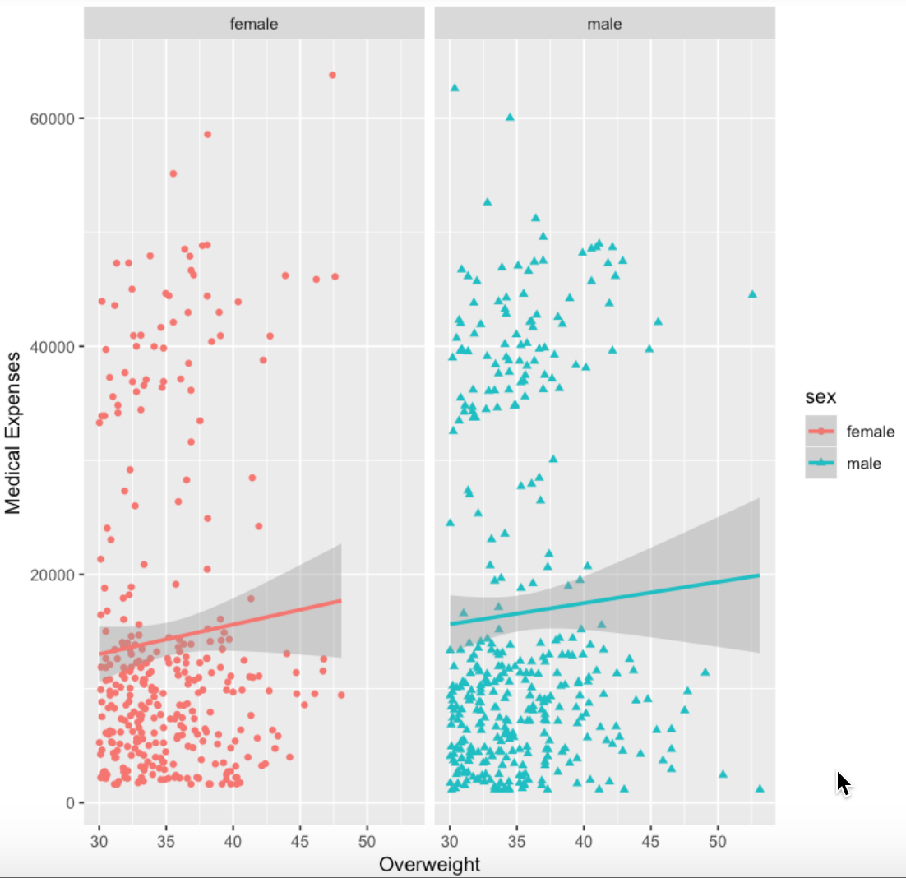
Subsetting overweight
Which is bmi > 30
Women has few BMI > 48 is because males' weight can be more than female's even though they share similar height.

Slide 13
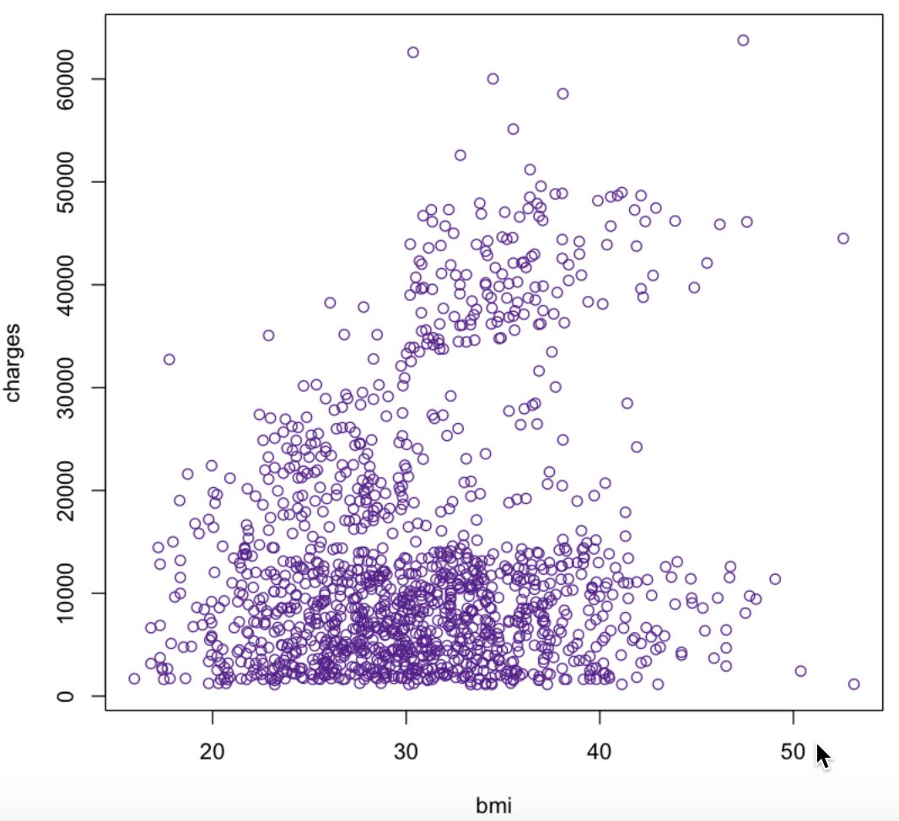
charges ~ bmi
doesn't make much sense.

Slide 14
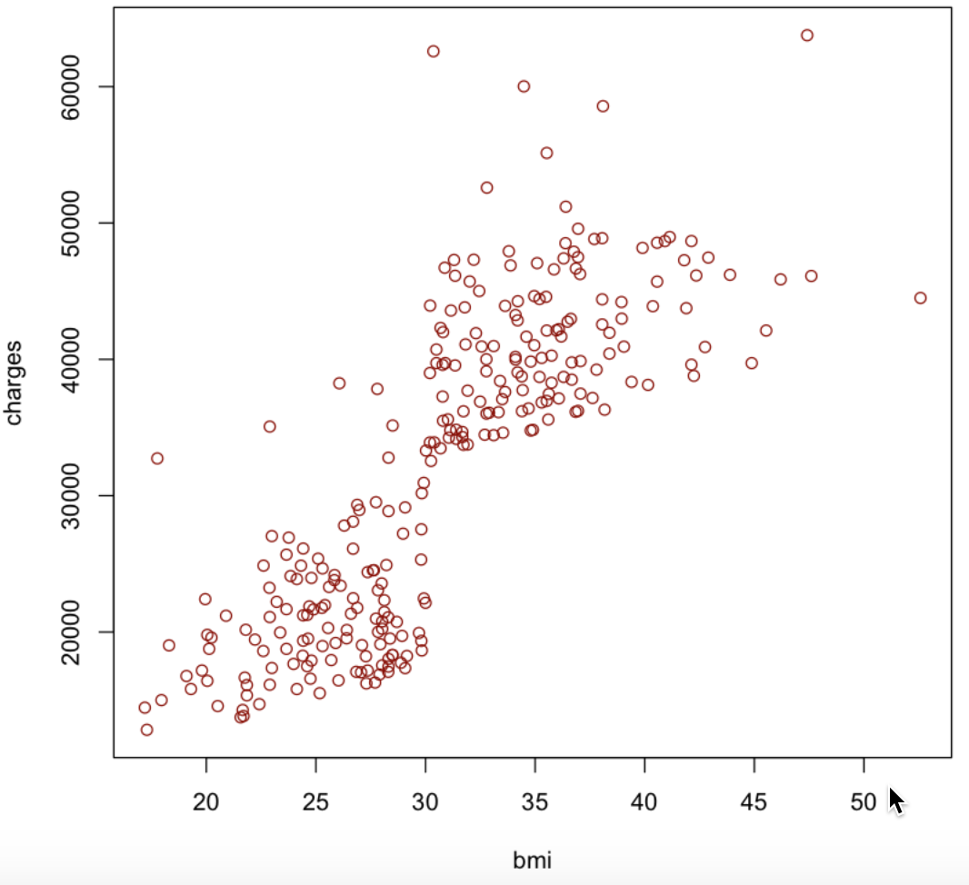
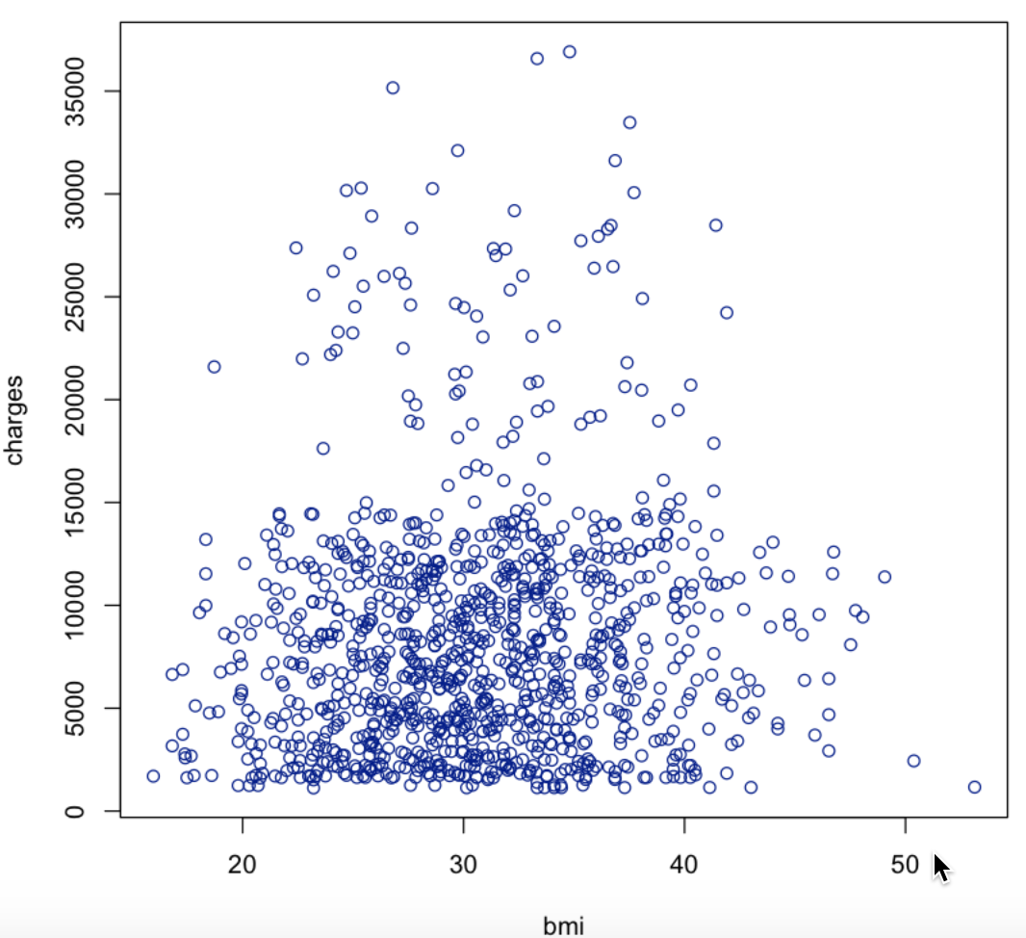
subsetting
smokers
nonsmoker

Slide 15
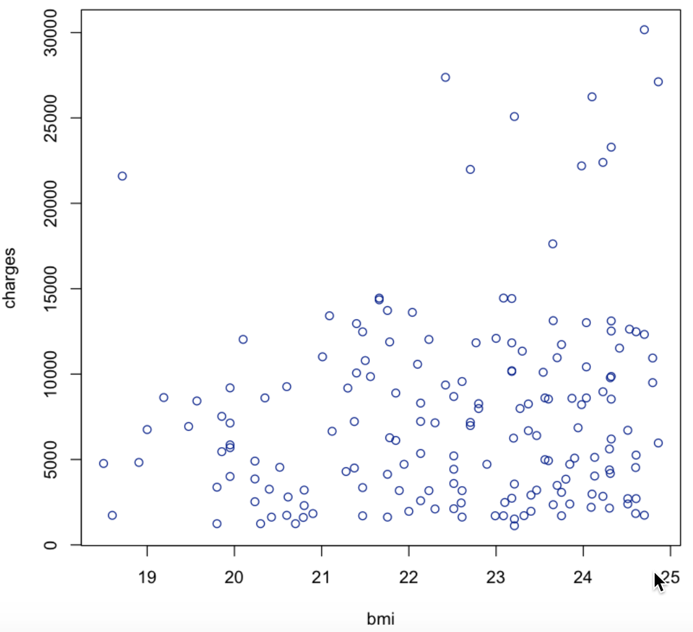
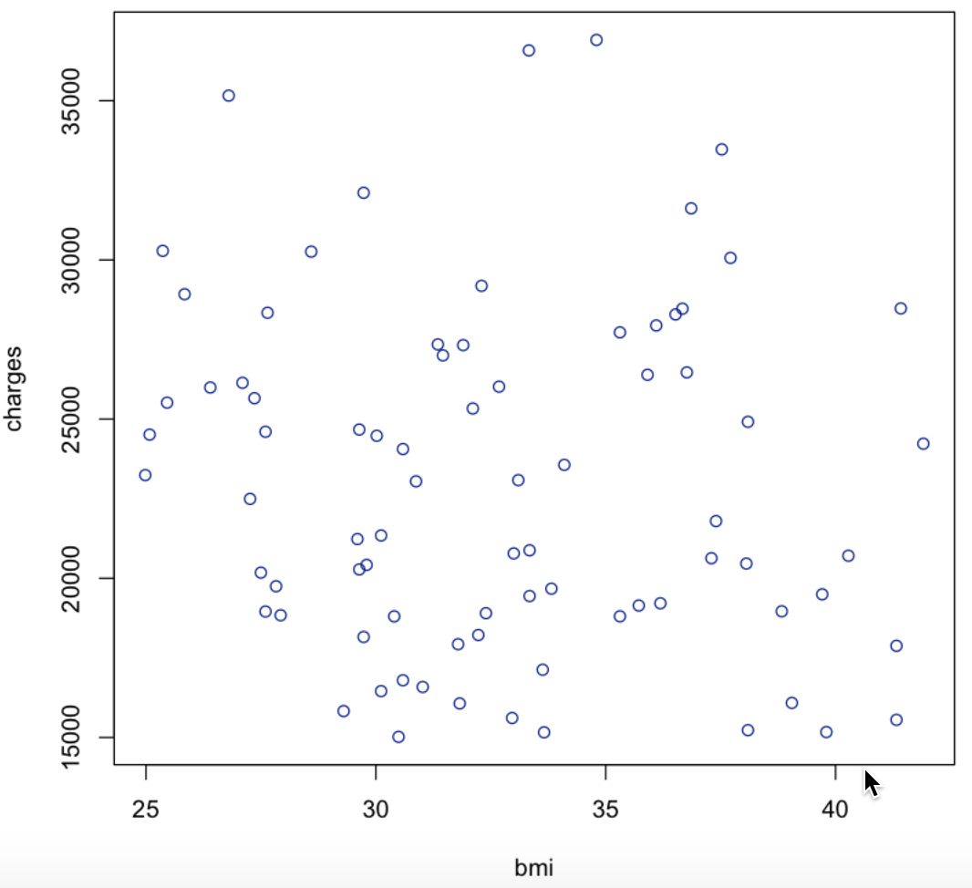
filtering
Normal_bmi
Large amount spending

Slide 16
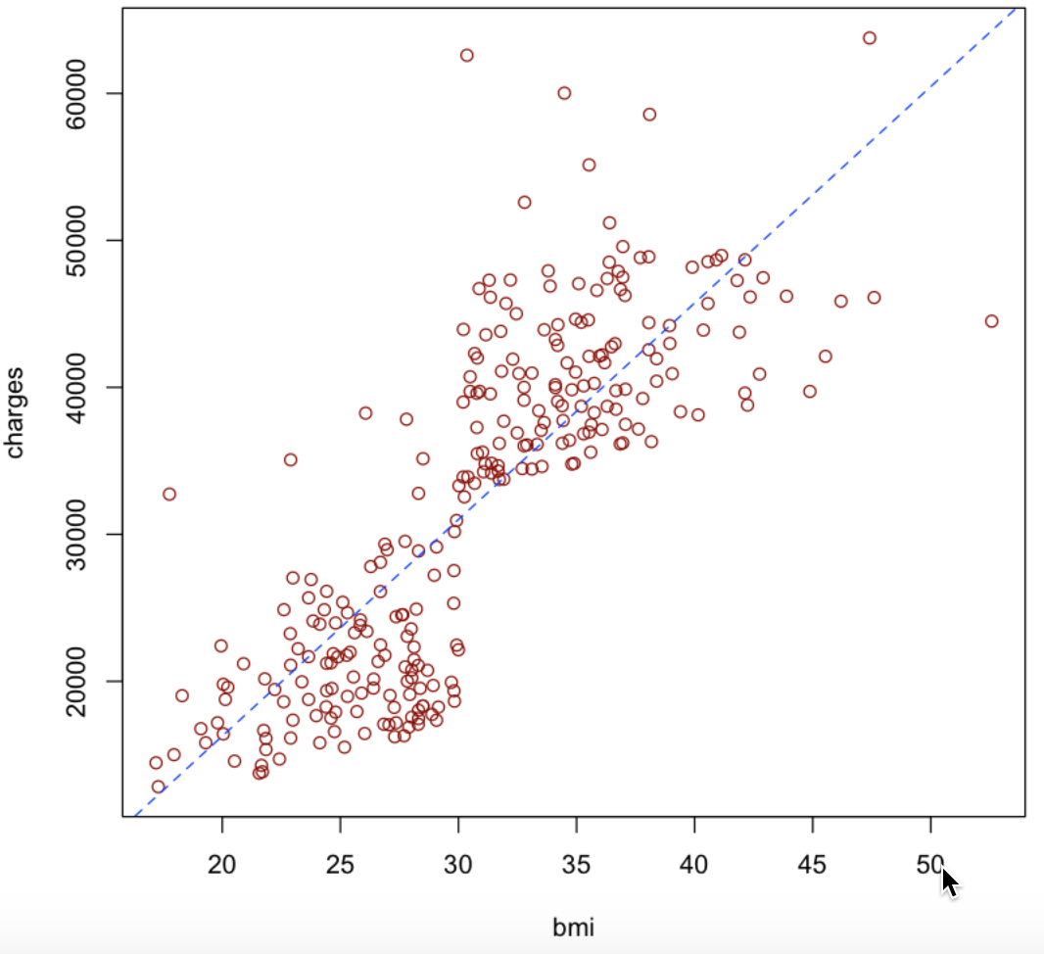
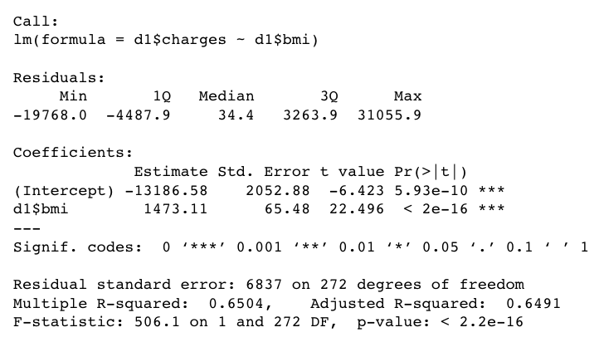
d1 <- d[d$smoker == "yes",]

Slide 17
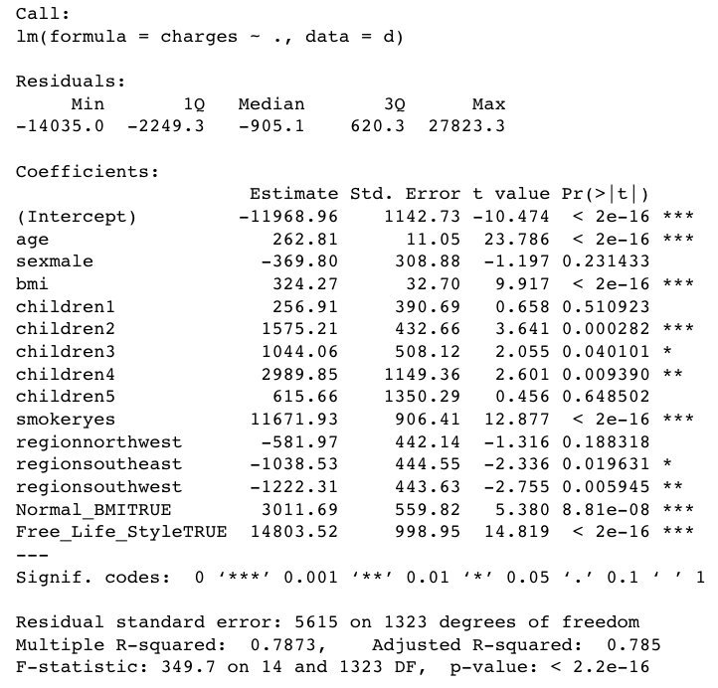
78.73%
New model with new colums

Slide 18
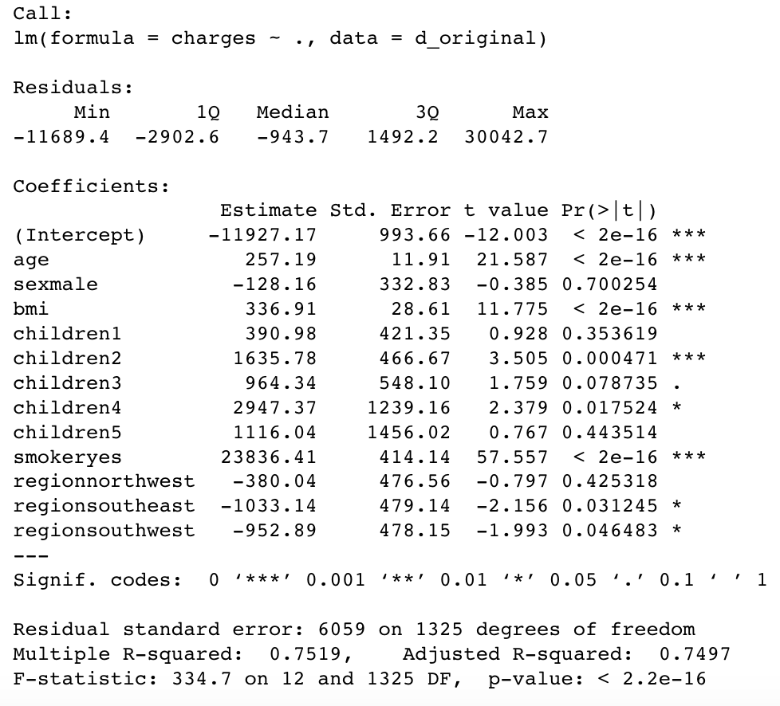
75.19%
Originally

Slide 19
Takeaway
Consider all variances
With both smoking and unhealthy BMI, people tend to spend more on medical expenses.
This model predicts best in Southwest region.
Gender does not affect the variance of response variables (medical expenses).
Age is always need to be considered.
This model is not so good predict people with too less or too many kids.

